Slide 1

Introduction to R for Data Science & Data Analytics
Salau Ayobami M.
Trainer
Thursday June 1st - Saturday June 3rd

Slide 2

Software For This Virtual Class
The Question is:
What is R?
Who has used R before?
What is it used for?

Slide 3
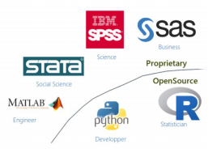
What is R?
▪ R is an open-source programming
language released in 1995 by Ross
Ihaka and Robert Gentleman to
improve the visualization and
data analysis features of a prior
syntax such as S.
▪ R is named partly after the first
names of the first two R authors
R vs Python
▪ R is mainly used for data analysis, while Python is used for general_x0002_purpose programing

Slide 4
Objectives
▪ The objective of this virtual Class is to introduce you to R and RStudio, which you'll be using throughout the virtual class to learn the Introduction to Data Science and Data Analytics.
▪ We have Sectioned the virtual class into a Three days teaching
▪ With (1)One hour alloted to each Module
▪ The Virtual Class will be hands-on-experience, carrying along Newbies, beginers, and experts
▪ We plan on looking into R as a tool and simulate a learning experience that will make us be prepared for the next phase of our Data Science and Analytics career.
▪ We also plan to make sure that R should be convenient to use for your Research no matter your discipline or Research Interest.
NB:
▪ To straighten out which is which: R is the name of the programming language itself and RStudio is a convenient interface.

Slide 5
Here's a breakdown of the course outline into a three-day learning schedule:
Day 1:
Time: 2pm-3pm
Module 1: Introduction to R and RStudio
- Overview of R and its applications in data science and data analytics
- Installing R and RStudio
- Understanding the RStudio interface
- Basic R syntax and data types
- Working with variables and basic arithmetic operations
Time: 3pm-4pm
Module 2: Data Manipulation with R
- Importing data into R from different file formats (e.g., CSV, Excel)
- Exploring and understanding data structures in R (vectors, matrices, data frames)
- Data cleaning and preprocessing techniques (handling missing values, data transformations)
Time: 4pm-5pm
Module 3: Exploratory Data Analysis (EDA) with R
- Introduction to descriptive statistics and visualization
- Generating summary statistics (mean, median, standard deviation, etc.)
- Creating basic data visualizations using ggplot2 package

Slide 6
Day 2:
Time: 2pm-3pm
Module 4: Statistical Analysis with R
- Introduction to statistical concepts in R (hypothesis testing, confidence intervals)
- Conducting t-tests and chi-square tests for categorical data
- Performing linear regression analysis to model relationships between variables
Time: 3pm-4pm
Module 5: Data Visualization with R
- Advanced data visualization using ggplot2 package
- Customizing plots (colors, labels, themes)
- Creating complex visualizations such as bar plots, histograms, box plots, and heatmaps
Time: 4pm-5pm
Module 6: Introduction to Machine Learning with R
- Overview of machine learning concepts and algorithms
- Supervised learning: classification and regression
- Unsupervised learning: clustering and dimensionality reduction

Slide 7
Day 3:
Time: 2pm-3pm
Module 7: Data Wrangling and Transformation
- Advanced data manipulation techniques using dplyr and tidyr packages
- Aggregating and summarizing data
- Reshaping data from wide to long format and vice versa
Time: 3pm-4pm
Module 8: Introduction to Big Data Analytics with R
- Overview of big data concepts and challenges
- Introduction to parallel computing and distributed systems
- Working with big data using R packages (e.g., dplyr, data.table)
Time: 4pm-5pm
Module 9: Data Science Project Workflow
- Understanding the end-to-end data science project lifecycle
- Formulating a data problem and defining project objectives
- Data acquisition and preparation
- Exploratory data analysis and feature engineering
Extras(To be given as a project or assignment)
Module 10: Case Studies and Practical Applications
- Applying R in real-world data science and data analytics scenarios
- Case studies across various domains (e.g., finance, healthcare, marketing)
- Solving practical problems using R and relevant packages
- Presenting and interpreting results effectively

Slide 8
Let’s Begin
Day 1:
Time: 2pm-3pm
Module 1: Introduction to R and RStudio
- Overview of R and its applications in data science and data analytics
- Installing R and RStudio
- Understanding the RStudio interface
- Basic R syntax and data types
- Working with variables and basic arithmetic operations

Slide 9
Overview of R and its applications in data science and data analytics
Applications of R in Data Science
Exploratory Data Analysis: R is widely used for exploratory data analysis to gain insights and understand patterns in data.
Statistical Modeling: R provides a robust framework for statistical modeling, allowing data scientists to build regression models, time series analysis, and other statistical techniques.
Machine Learning: R offers a wide range of machine learning algorithms and frameworks, making it suitable for tasks like classification, regression, and recommendation systems.
Natural Language Processing: R has packages for natural language processing tasks such as text mining, sentiment analysis, and language modeling.
Data Visualization: R's visualization libraries, such as ggplot2, enable data scientists to create interactive and visually appealing plots and charts.
Applications of R in Data Analytics
Business Analytics: R is used in business analytics for tasks like forecasting sales, customer segmentation, and market basket analysis.
Financial Analysis: R is employed in financial analysis for portfolio optimization, risk modeling, and financial forecasting.
Healthcare Analytics: R is utilized in healthcare analytics for tasks like disease prediction, patient monitoring, and medical image analysis.
Social Media Analytics: R can be applied to analyze social media data, sentiment analysis, and social network analysis.
Marketing Analytics: R is used for customer segmentation, churn prediction, and marketing campaign analysis.

Slide 10
Installing R and RStudio
Installation of R
Installing R
▪ R is available for free on the Comprehensive R Archive Network
(CRAN) website
▪ Step 1: Open the R Project Homepage: www.r-project.org
▪ Step 2: Click on the “CRAN” link on the menu on the left-hand side of the page. Pick
the server that is (geographically) closest to you.
▪ Step 3: Find your operating system (Windows, Macintosh, Linux, etc.) under
“Precompiled Binary Distributions”. These are the ready-to-install files containing the
base R package, and are the easiest way to get R up and running on your machine.
▪ Windows:
▪ Click Download R for Windows.
▪ Click base.
▪ Click Download R-4.2.2 for Windows. Save it to a file on your hard drive. (Note: the
installation file is about 76 Megabytes. If you have a slow Internet connection, download
the installation file on a machine with a fast connection.
▪ Find the installation file “R-4.2.2-win.exe” on your hard drive.
▪ Close all other programs before beginning the installation.
▪ Run the installation program with administrative privileges.

Slide 11
Installing R
▪ Mac OS X :
▪ Click Download R for macOS.
▪ Click either R-4.2.2-arm64.pkg or R-4.2.2.pkg to download R based on your computer settings.
▪ To install R, simply double-click on the icon of the downloaded package file.
▪ Linux
▪ Follow the instruction to install appropriate package

Slide 12
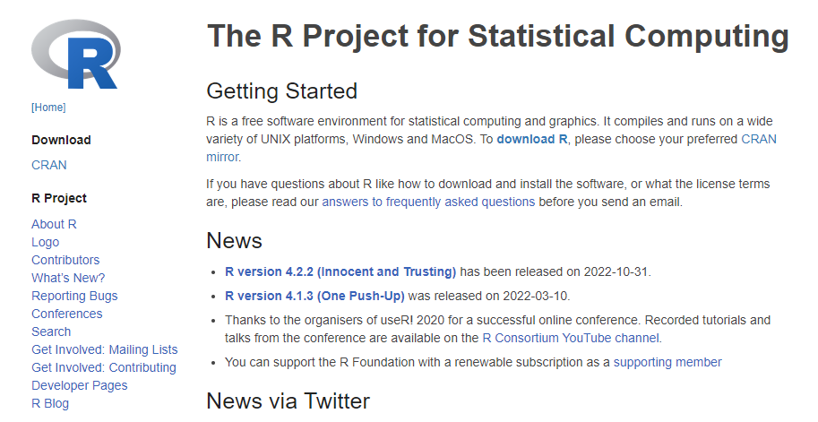
Installing R – Demo for Windows

Slide 13
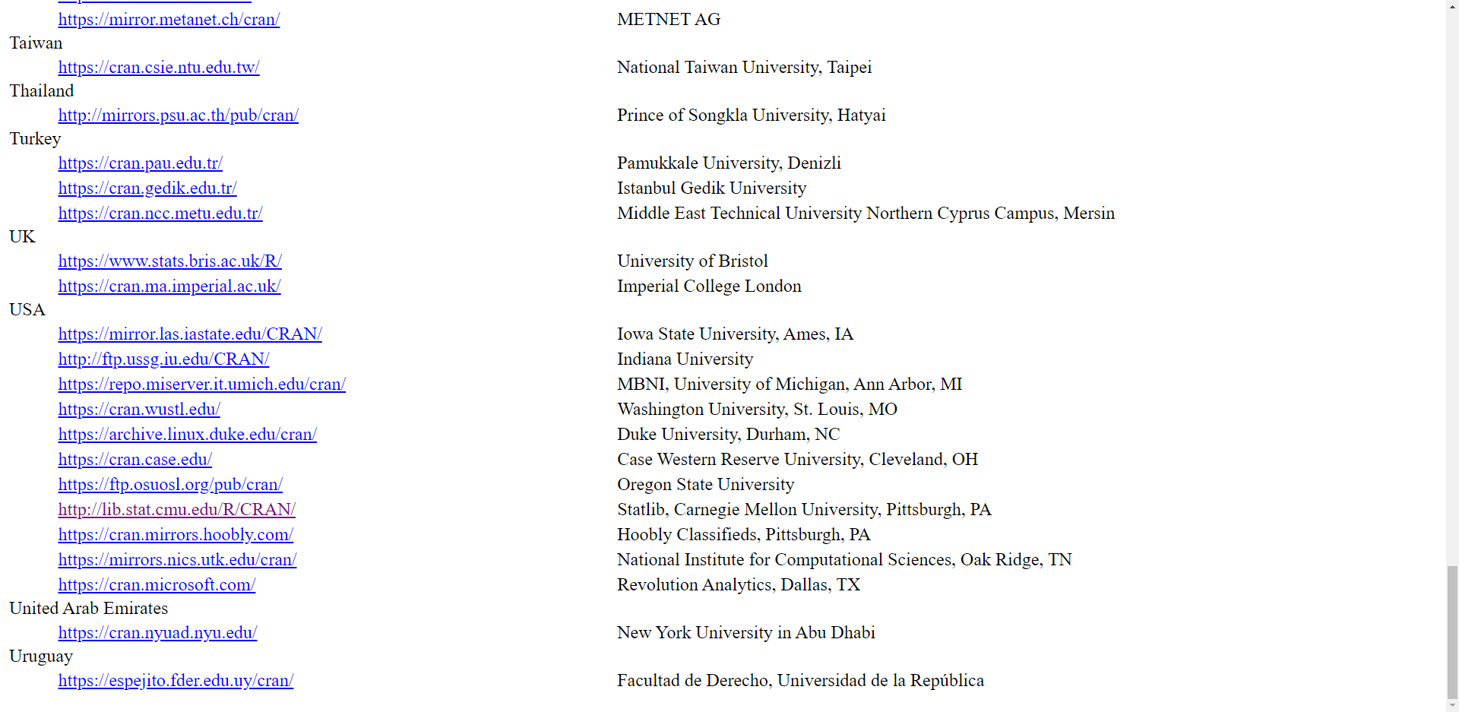
Installing R – Demo for Windows

Slide 14
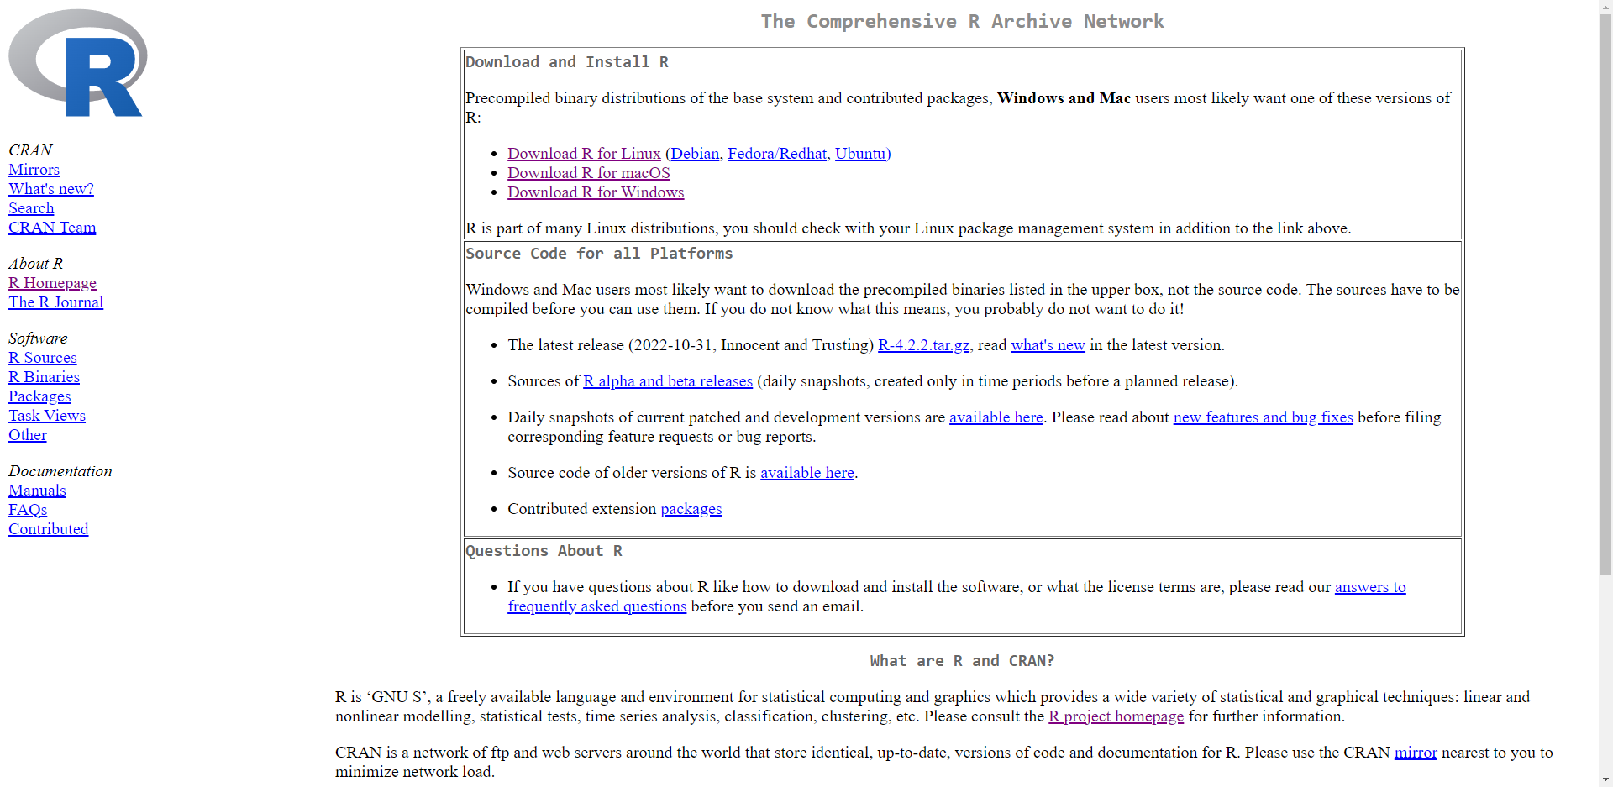
Installing R – Demo for Windows

Slide 15
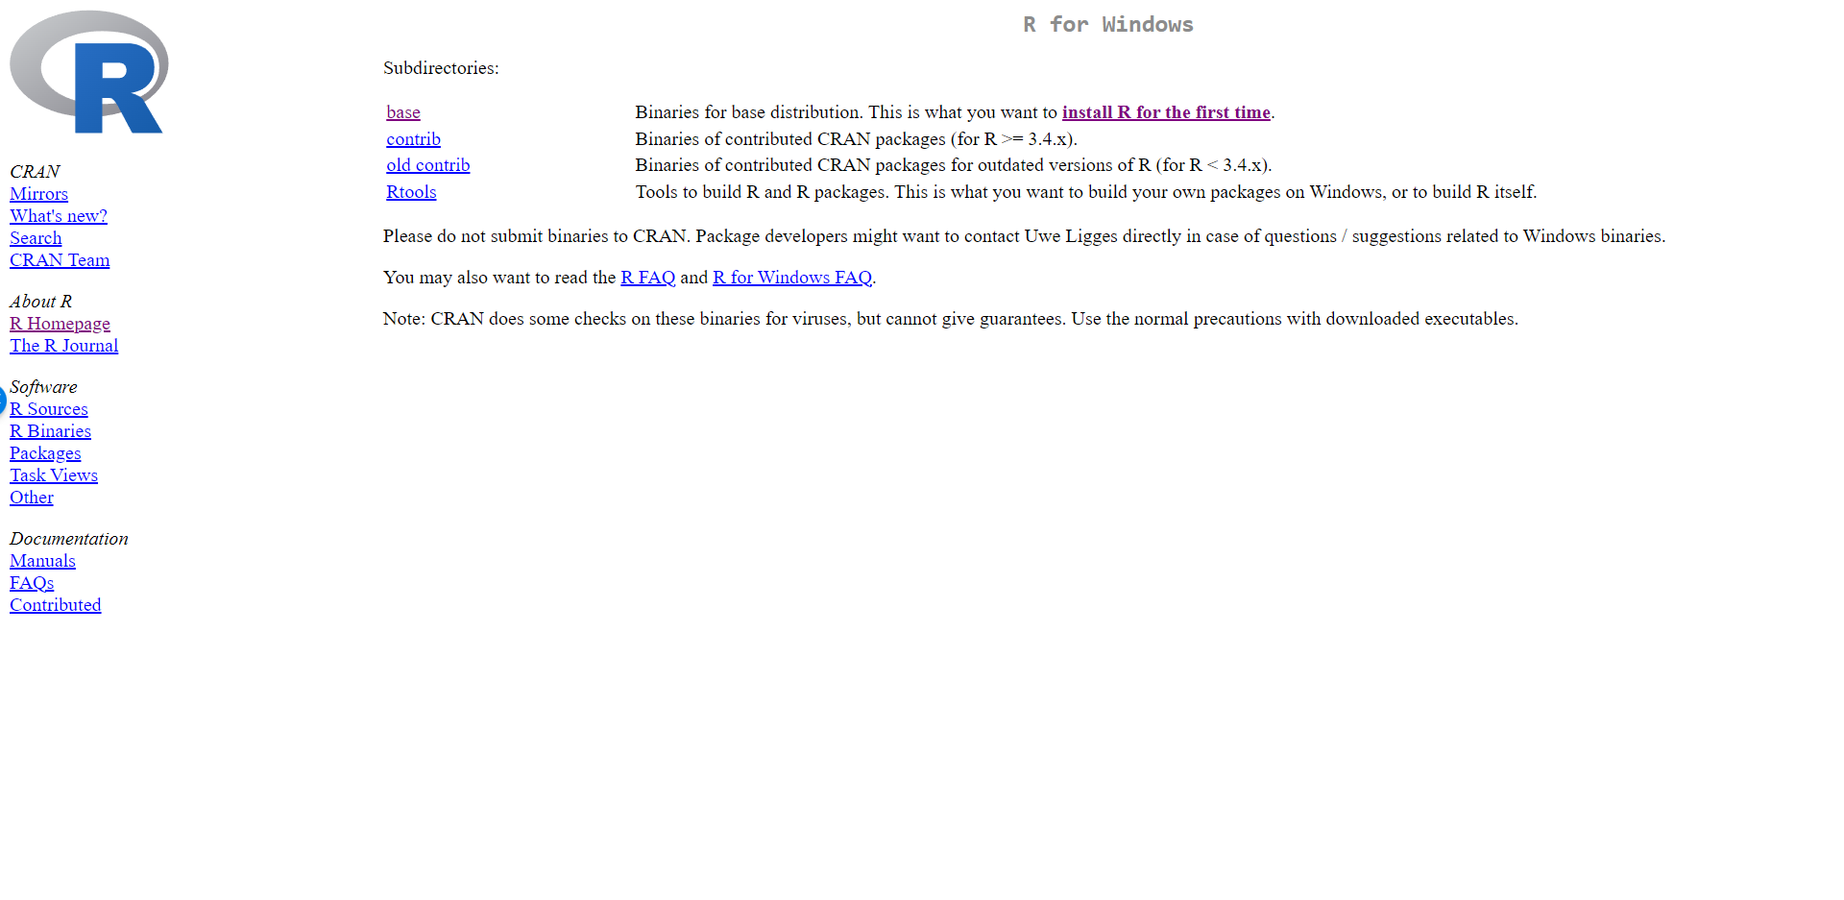
Installing R – Demo for Windows

Slide 16
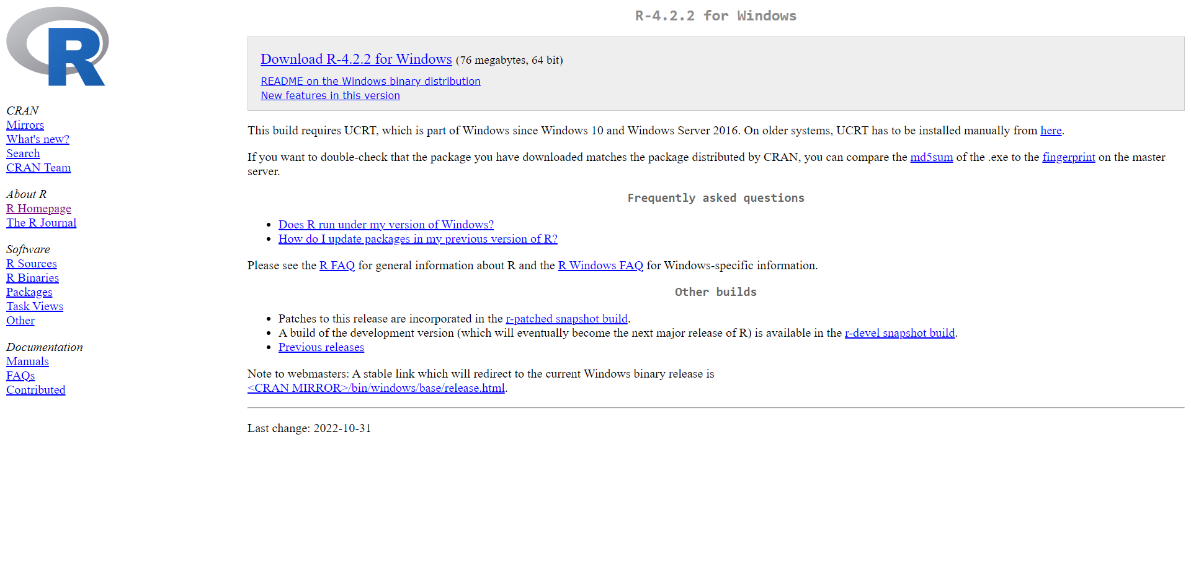
Installing R – Demo for Windows

Slide 17
Installation of RStudio
RStudio
▪ RStudio Integrated development environment (IDE) is a powerful and productive user interface for R. It’s free and open source, and works great on Windows, Mac, and Linux.
▪ Download: www.rstudio.com

Slide 18
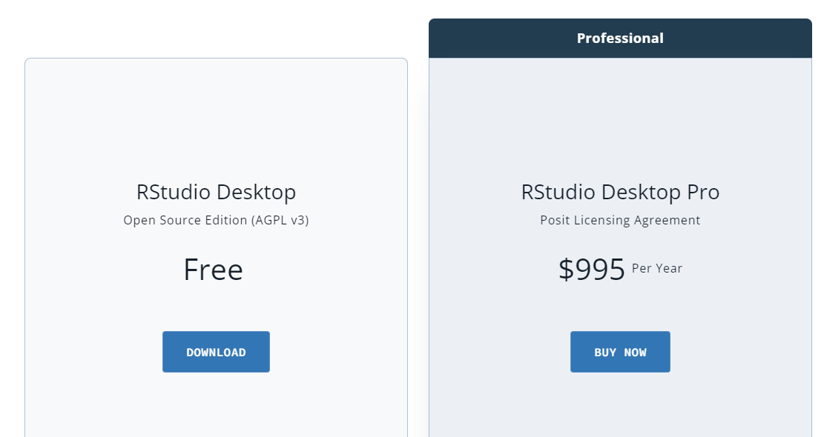
RStudio

Slide 19
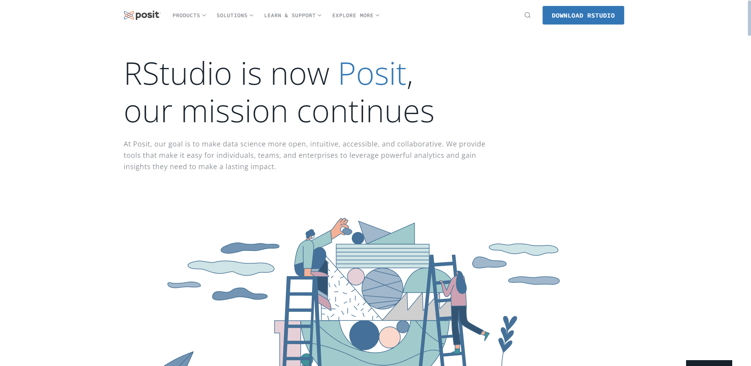
Installing RStudio - Demo

Slide 20
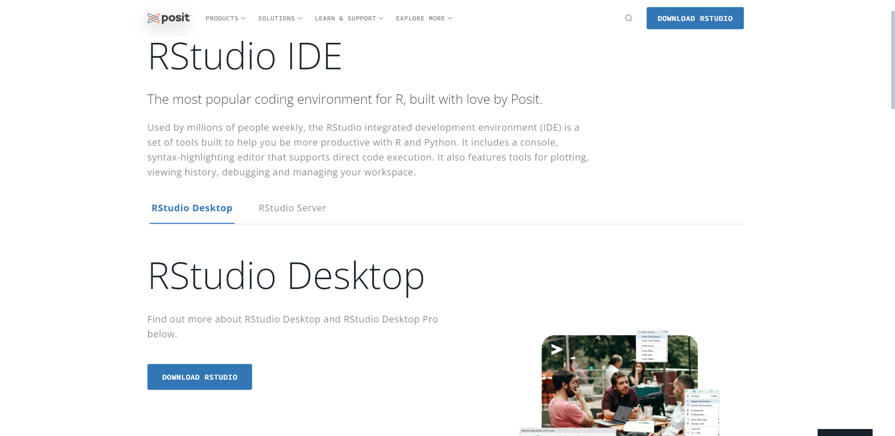
Installing RStudio - Demo

Slide 21
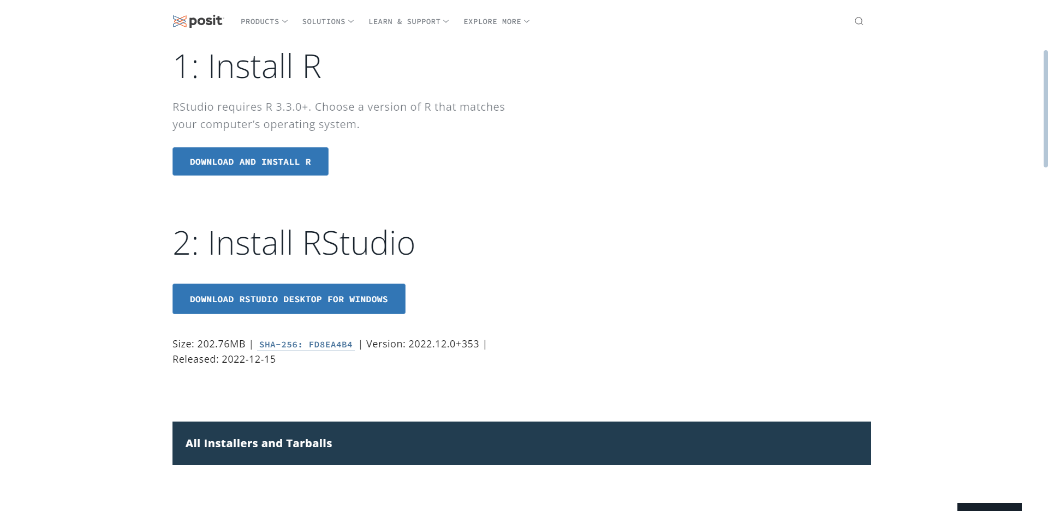
Installing RStudio - Demo

Slide 22
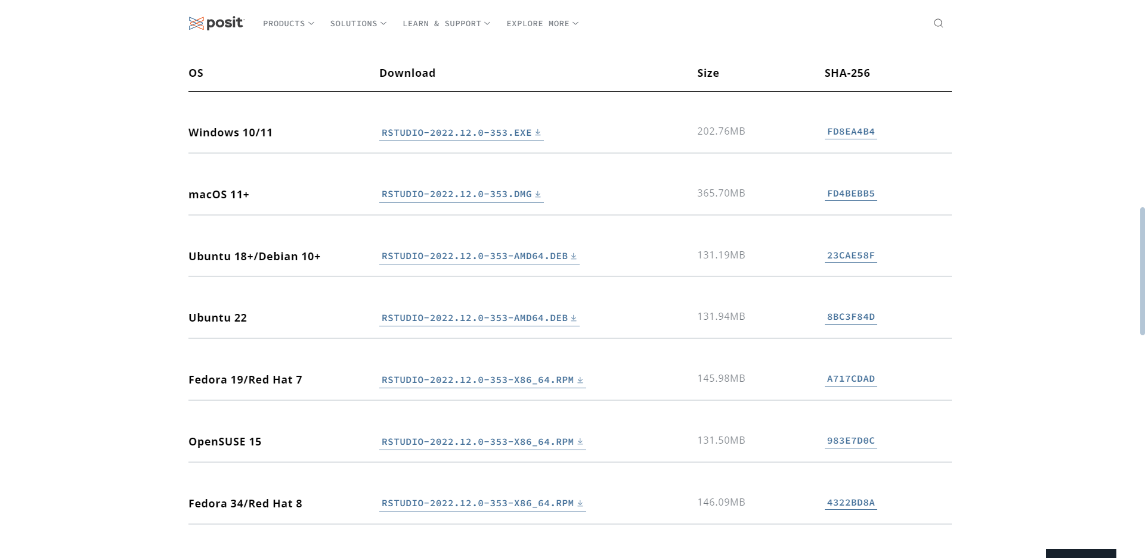
Installing RStudio - Demo

Slide 23
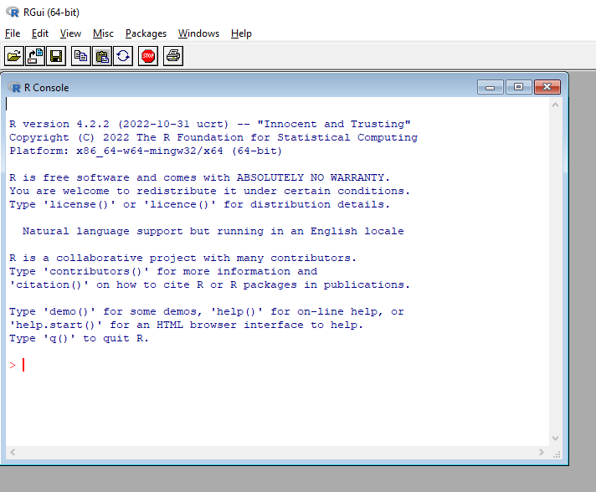
R Interface
▪ Open R interface:
▪ Open Start Menu
▪ Go to the folder R
▪ Click R.4.2.2

Slide 24
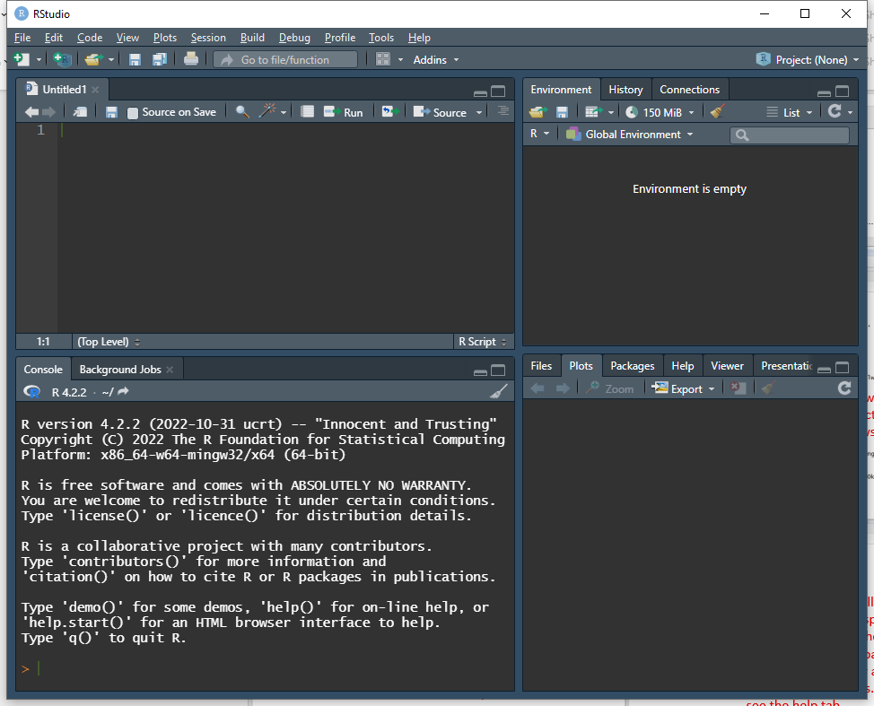
RStudio Interface
▪ Open RStudio interface:
▪ Open Start Menu
▪ Go to the folder RStudio
▪ Click RStudio
Note: RStudio appearance can be changed

Slide 25
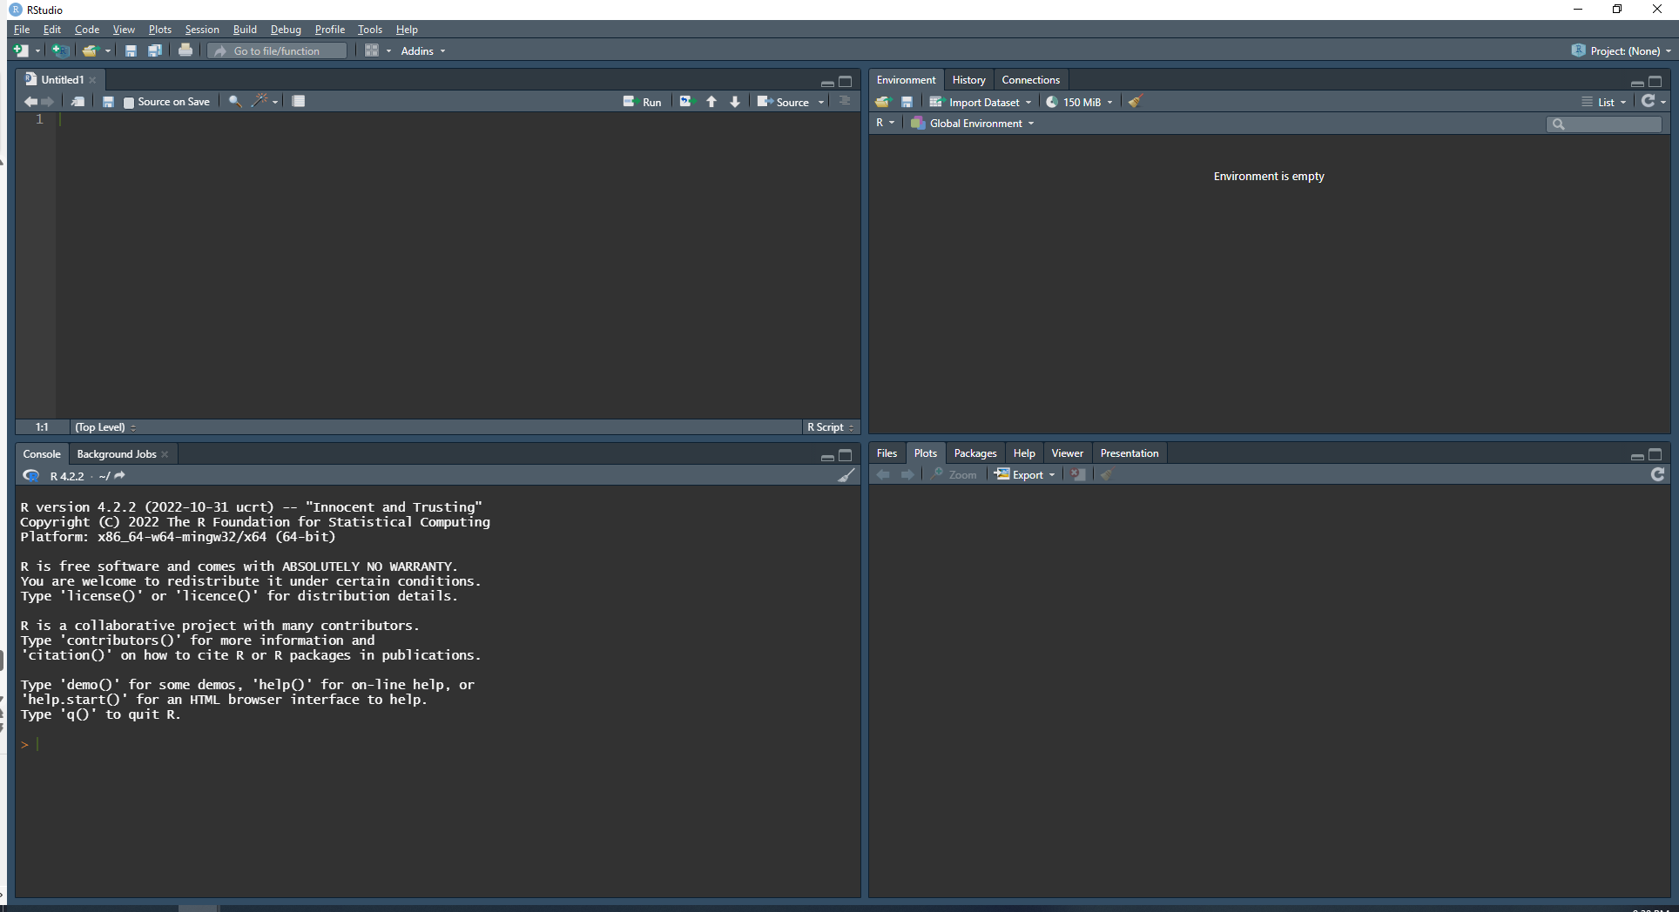
RStudio Interface
The source panel is where you write
your script.
The workspace tab shows all the active
objects. The history tab shows a list of
commands used so far.
The files tab shows all the files and folders
in your default workspace as if you were on
a PC/Mac window. The plots tab will show
all your graphs. The packages tab will list a
series of packages or add-ons needed to
run certain processes. For additional info
see the help tab.
The console panel is where you can type
commands and see output.

Slide 26
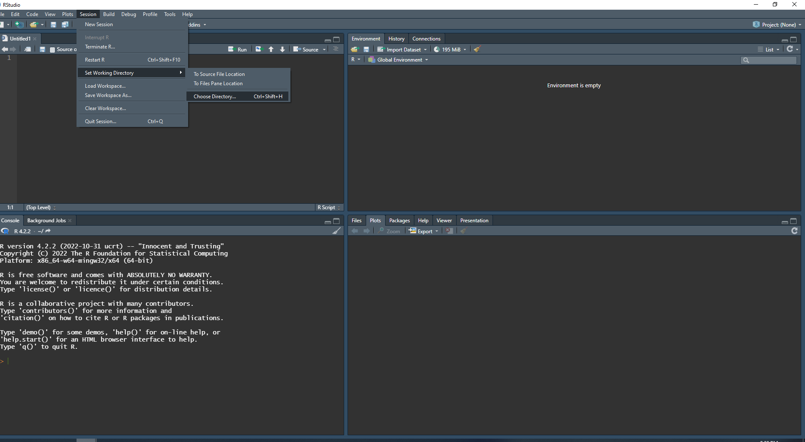
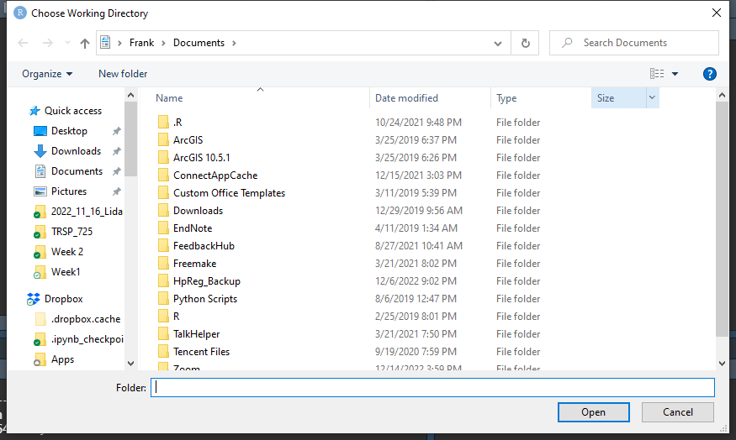
Change Working Directory
If you have different projects, you can
change the working directory for that
session, see above. Or you can type:
# Show the working directory (wd)
getwd()
# Change the wd
setwd("C:/myfolder/data")

Slide 27
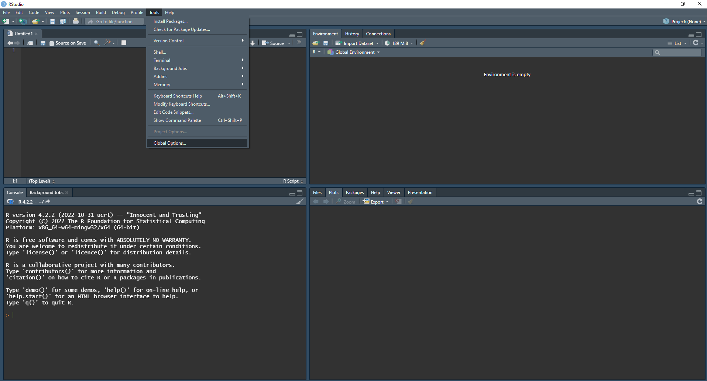
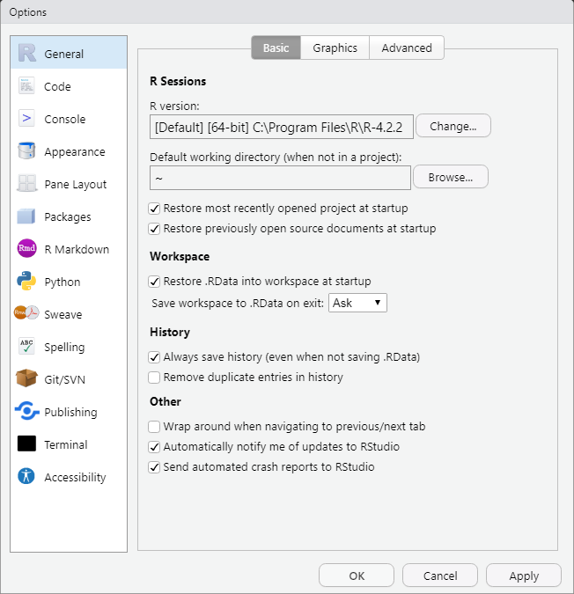
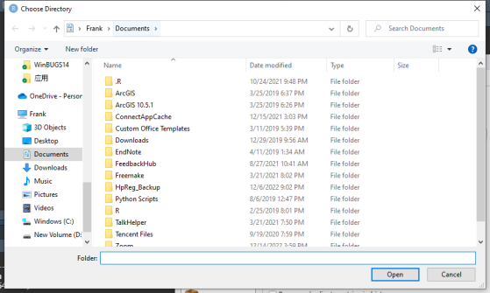
Setup a Default Working Directory

Slide 28
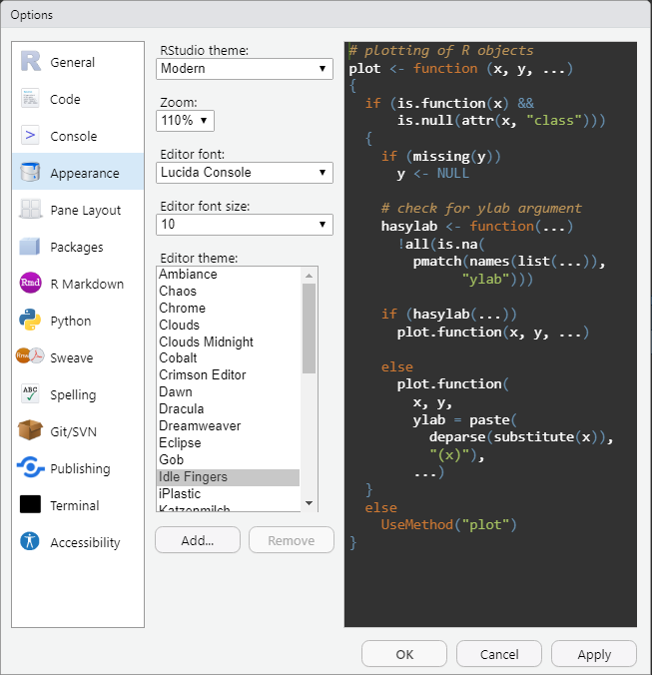
Change Appearance

Slide 29
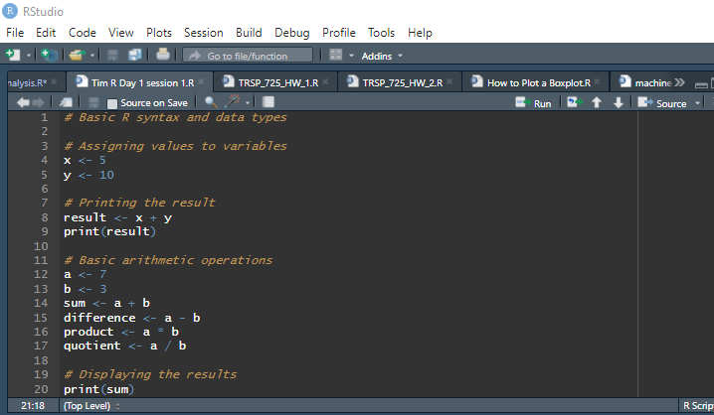
Let’s Begin Hand’s-on
- Basic R syntax and data types
- Working with variables and basic arithmetic operations

Slide 30
Time: 3pm-4pm
Module 2: Data Manipulation with R
- Importing data into R from different file formats (e.g., CSV, Excel)
- Exploring and understanding data structures in R (vectors, matrices, data frames)
- Data cleaning and preprocessing techniques (handling missing values, data transformations)

Slide 31
Time: 4pm-5pm
Module 3: Exploratory Data Analysis (EDA) with R
- Introduction to descriptive statistics and visualization
- Generating summary statistics (mean, median, standard deviation, etc.)
- Creating basic data visualizations using ggplot2 package

Slide 32
END OF DAY 1

Slide 33
Day 2:
Time: 2pm-3pm
Module 4: Statistical Analysis with R
- Introduction to statistical concepts in R (hypothesis testing, confidence intervals)
- Conducting t-tests and chi-square tests for categorical data
- Performing linear regression analysis to model relationships between variables

Slide 34
Time: 3pm-4pm
Module 5: Data Visualization with R
- Advanced data visualization using ggplot2 package
- Customizing plots (colors, labels, themes)
- Creating complex visualizations such as bar plots, histograms, box plots, and heatmaps

Slide 35
Time: 4pm-5pm
Module 6: Introduction to Machine Learning with R
- Overview of machine learning concepts and algorithms
- Supervised learning: classification and regression
- Unsupervised learning: clustering and dimensionality reduction

Slide 36
END OF DAY 2

Slide 37
Day 3:
Time: 2pm-3pm
Module 7: Data Wrangling and Transformation
- Advanced data manipulation techniques using dplyr and tidyr packages
- Aggregating and summarizing data
- Reshaping data from wide to long format and vice versa

Slide 38
Time: 3pm-4pm
Module 8: Introduction to Big Data Analytics with R
- Overview of big data concepts and challenges
- Introduction to parallel computing and distributed systems
- Working with big data using R packages (e.g., dplyr, data.table)

Slide 39
Time: 4pm-5pm
Module 9: Data Science Project Workflow
- Understanding the end-to-end data science project lifecycle
- Formulating a data problem and defining project objectives
- Data acquisition and preparation
- Exploratory data analysis and feature engineering

Slide 40
END OF DAY 3

Slide 41
WHAT NEXT?

Slide 42
Extras(To be given as a project or assignment)
Module 10: Case Studies and Practical Applications
- Applying R in real-world data science and data analytics scenarios
- Case studies across various domains (e.g., finance, healthcare, marketing)
- Solving practical problems using R and relevant packages
- Presenting and interpreting results effectively

